Slide 1
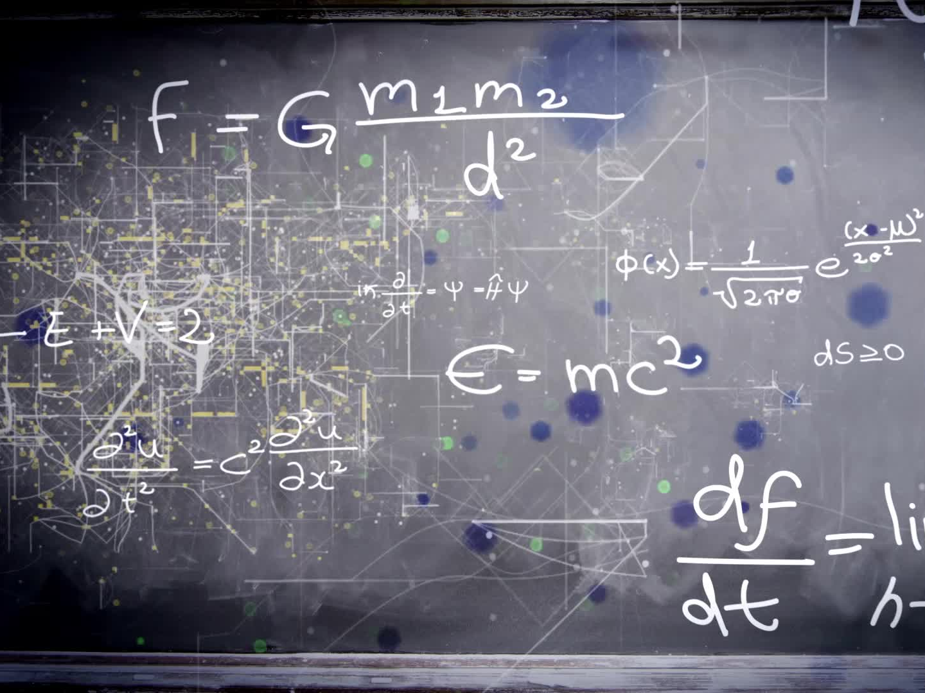
Quantum-Enhanced QLSTM ETF Prediction
Overview of Project Workflow and Achievements

Slide 2
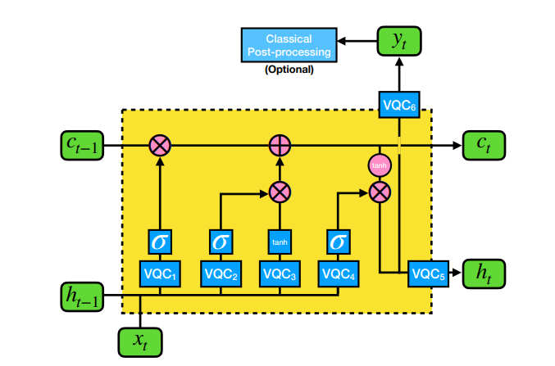
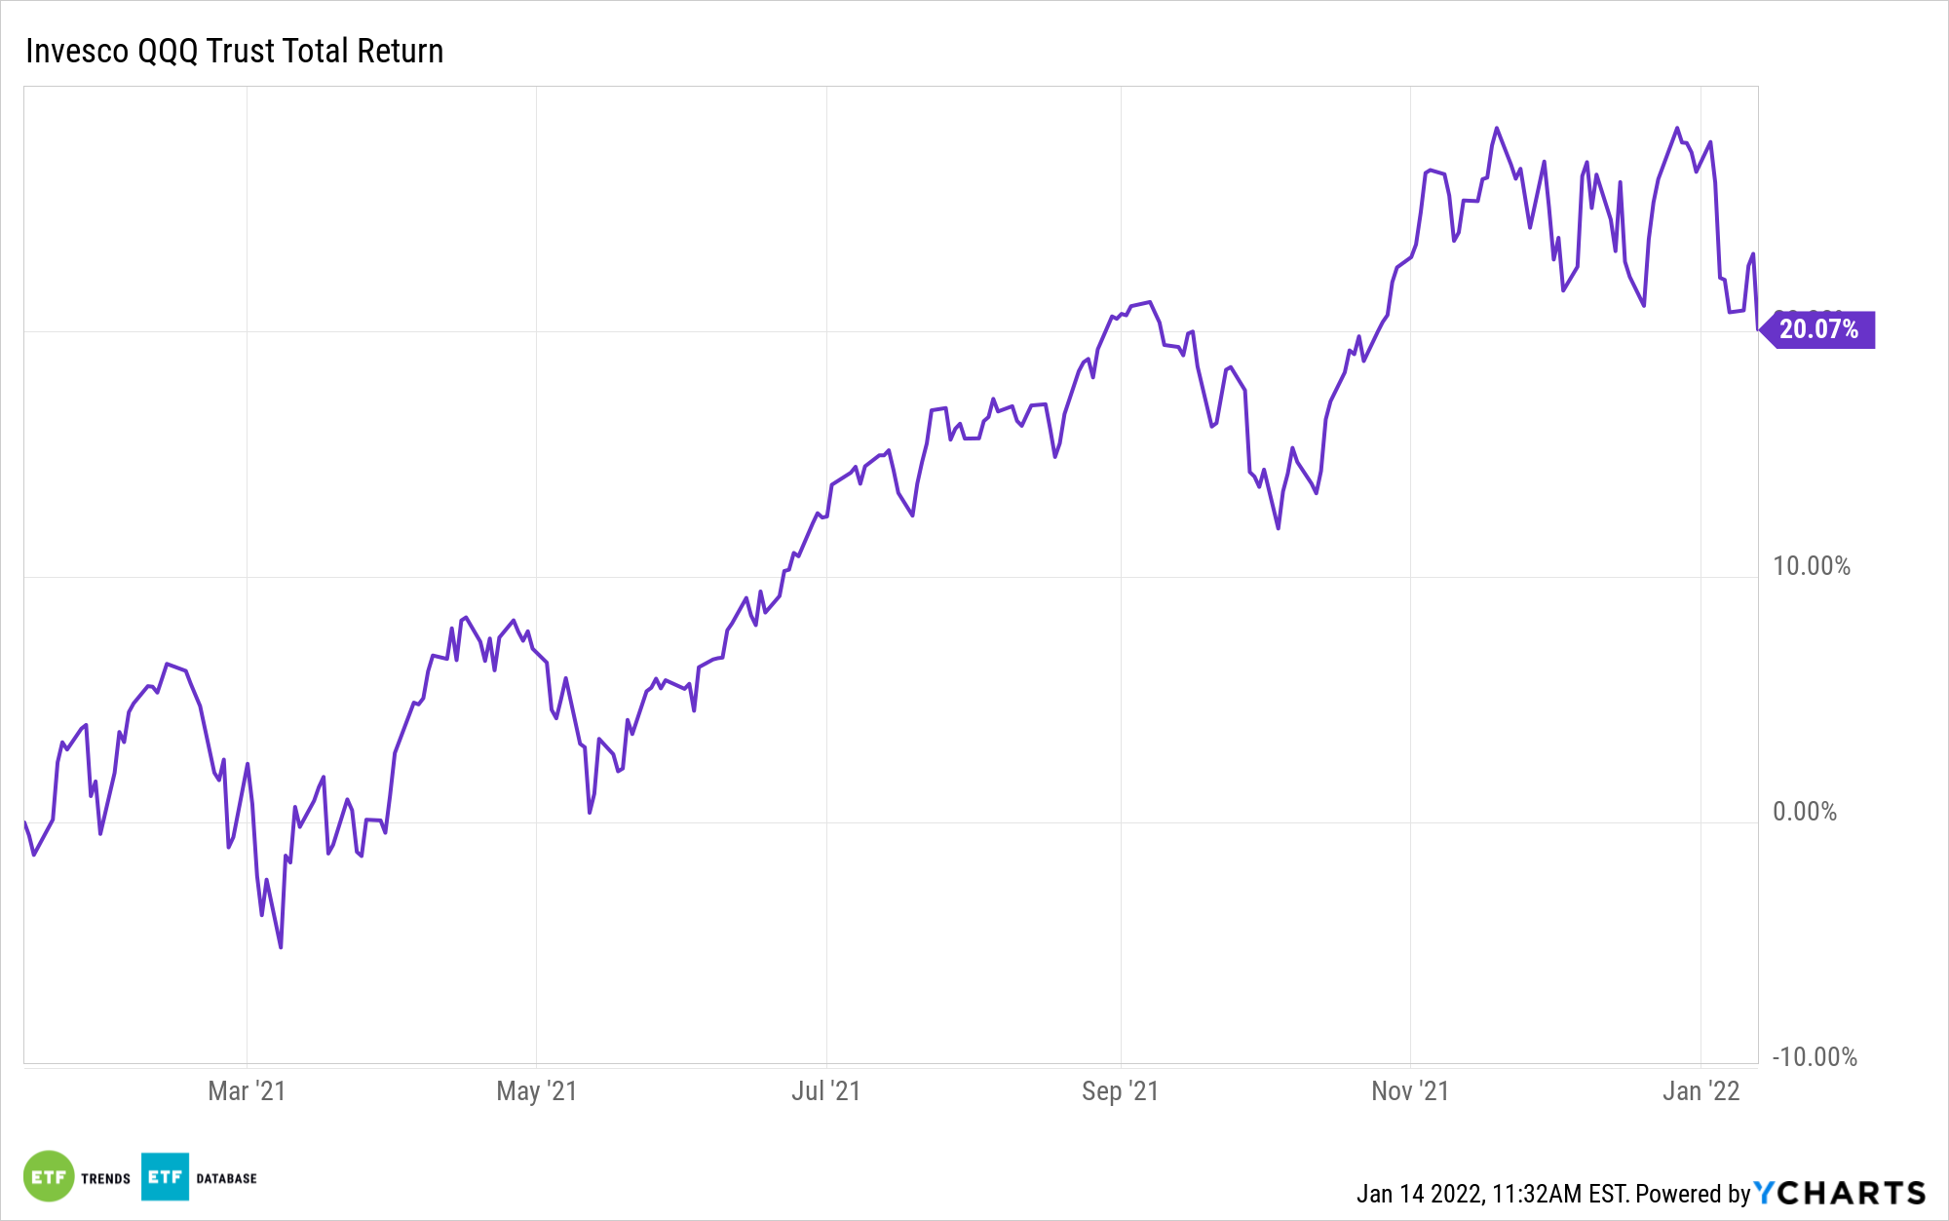
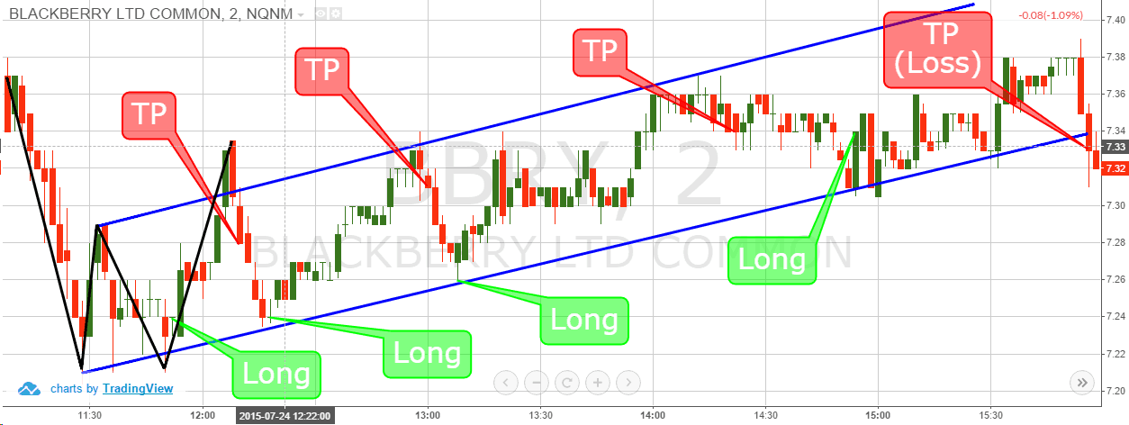
Heart of My Project
Goal is to apply ‘Quantum Long Short-Term Memory’ or QLSTM as a price prediction tool for financial devices, ETFs in particular

Slide 3

The Rise of Quantum Algorithms
Quantum computing offers new paradigms for problem-solving
Potential for exponential speedups in certain tasks
Growing interest in finance and machine learning applications

Slide 4


Slide 5
Choosing QLSTM
I chose to focus on QLSTM because in the research I found, LSTM is a recurrent Neural Network (RNN) applicable to a broad range of problems aiming to analyze or classify sequential data.
- Perfect for financial data !
Existing researchers have used LSTM to predict the future stock price based on the historical data sequences with great success.
- Existing research !
Augments classical LSTM with quantum-inspired layers
Lightweight: avoids heavy quantum circuits
Captures non-linear patterns in time-series data

Slide 6
What is QLSTM?
Hailed as a ‘cutting-edge fusion of quantum computing principles and neural network principles’
Builds on top of LSTM

Slide 7
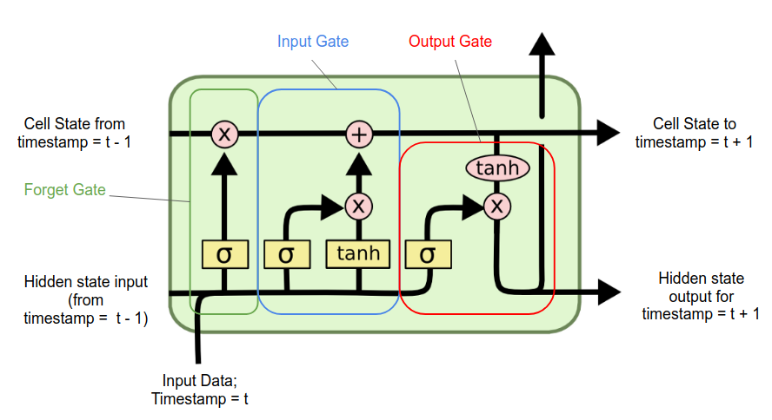
What is LSTM?
A recurrent neural network (RNN) architecture widely used in Deep Learning.
Excels at capturing long-term dependencies, making it ideal for sequence prediction tasks

Slide 8
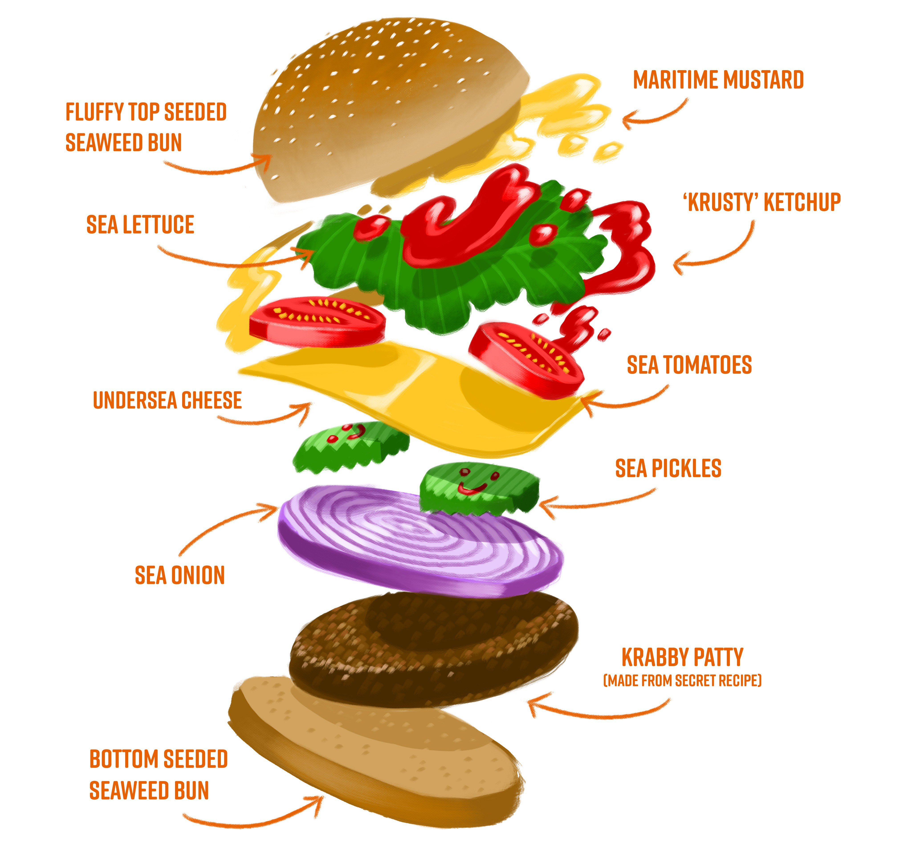
So what is QLSTM?
Replaces foundational layers of the LSTM neural network with various quantum layers

Slide 9
Now let’s focus on data
Gathered 30-minute QQQ ETF ticks for 2020
Key metrics like: MA, EMA, MACD, Bollinger Bands, Momentum

Slide 10
In conclusion

Slide 11
References
Integrate full quantum hardware runs
Explore multi-asset portfolios
Refine models with advanced quantum kernels

